Slide 1
SkillSense
Mockup:Feature expansion

Slide 2
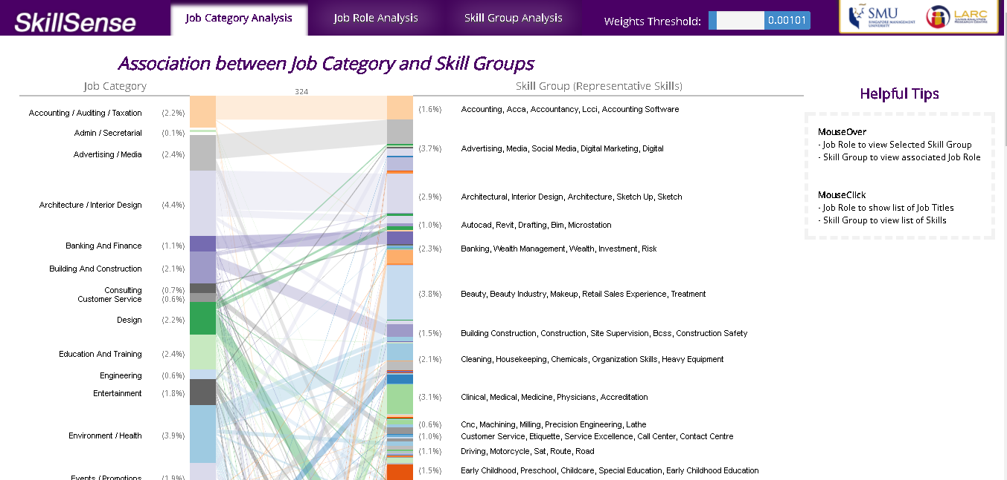

Input : “Journalism”

Slide 3
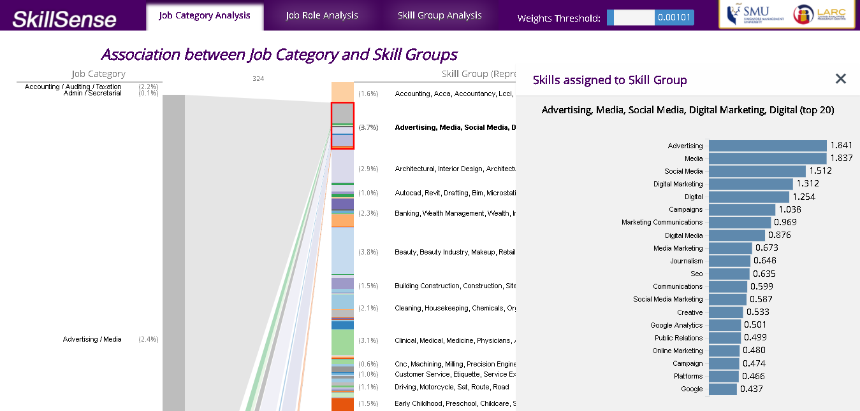
Belong to
Input : “Journalism”
Identified Job Categories

